Slide 1



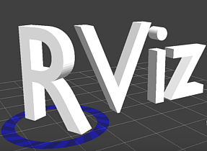

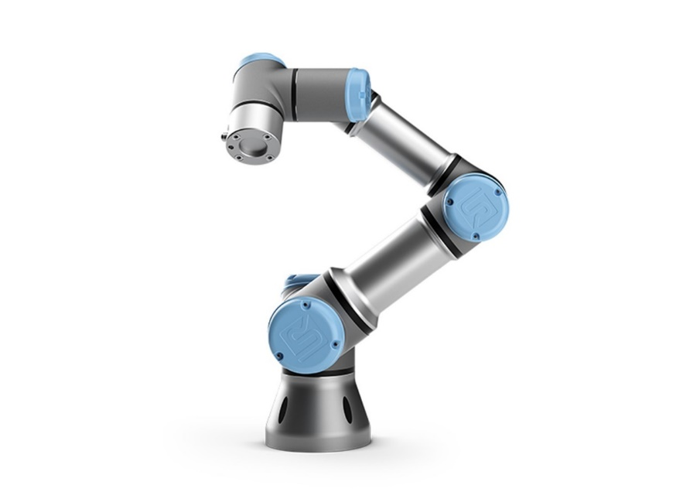
ROS & Gazebo design of an assembly line for assembling road reflectors—parts pick & place
Li Huang and Haoran Zhao

Slide 2
ROS & Programming
ROS nodes
Topic publisher and subscriber
Customized message type
Image processing—OpenCV
UR5 & UR3 motion planning—Rvitz, MoveIt!
Gazebo plugins
Tools: roslaunch, rostopic, rosservice, rqt graph, rqt plot
Notes:
In this project we covered several ros concepts. We programmed camera detection and motion planning as separate node to improve the processing speed. We passed useful information stored in customized message by publishers and subcribers. We also implemented gazebo camera plugin and vacuum gripper plugin, and we used opencv for image processing. the tools we used in this project are roslaunch, rostopic, rosservice, rqt_graph, and rqt_plot.

Slide 3
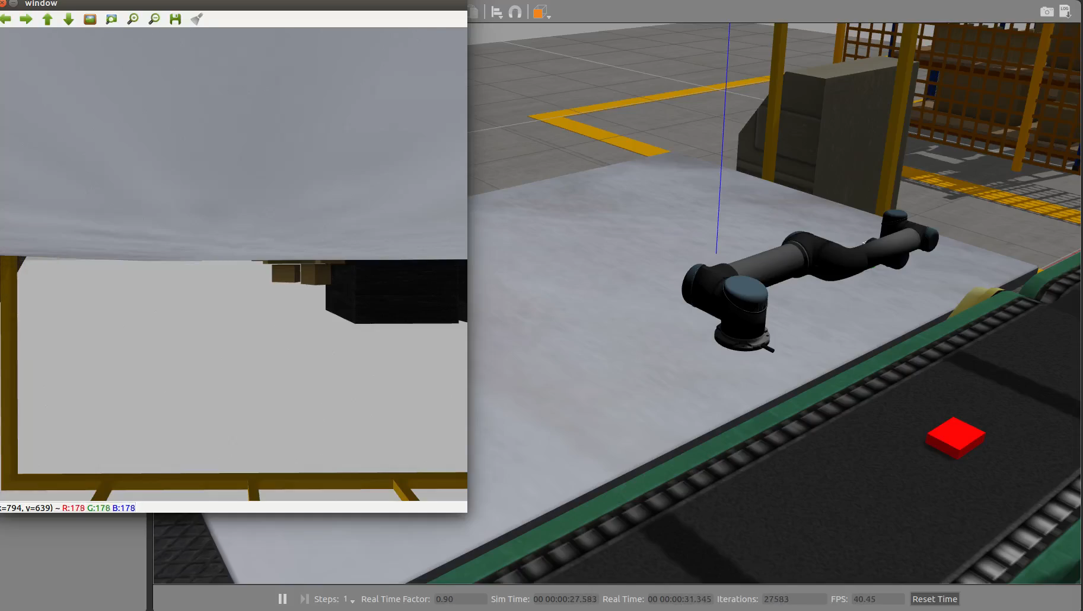
Images from the USB cam
Notes:
This is what we have done before the midterm presentation, as you can see here, we didn’t implement motion planning for tracking objects and gripper operation.

Slide 4
Challenges
Gazebo environment: moving objects and conveyor animation
Gripper implementation
Tracking, pick & place object on the conveyor
UR3 hardware implementation

Slide 5
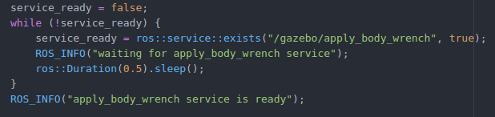
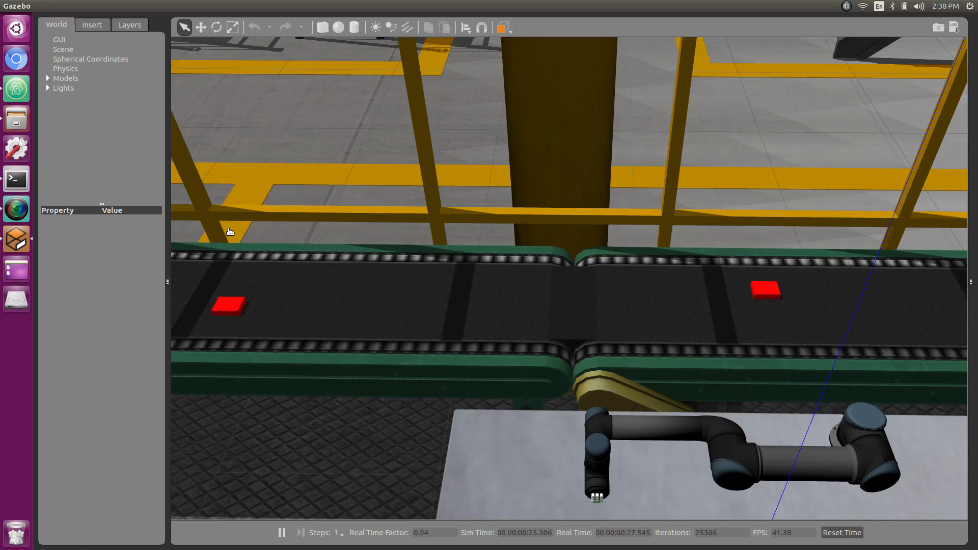
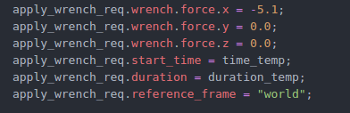
Conveyor simulation

Slide 6
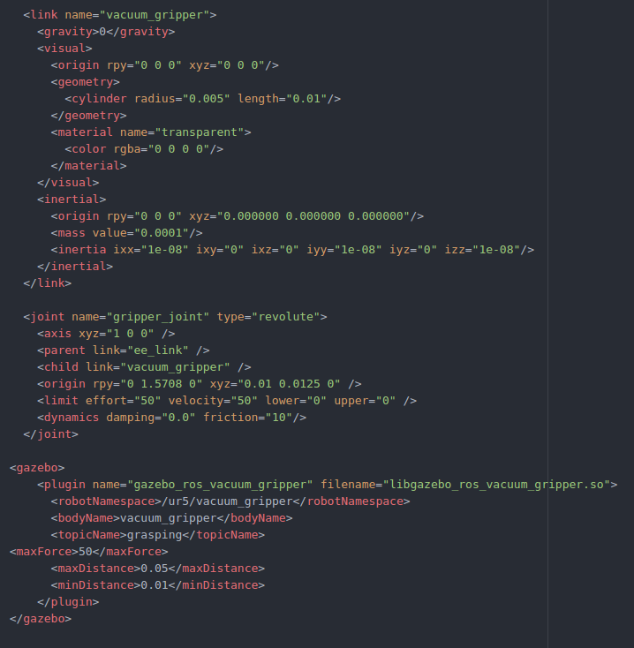
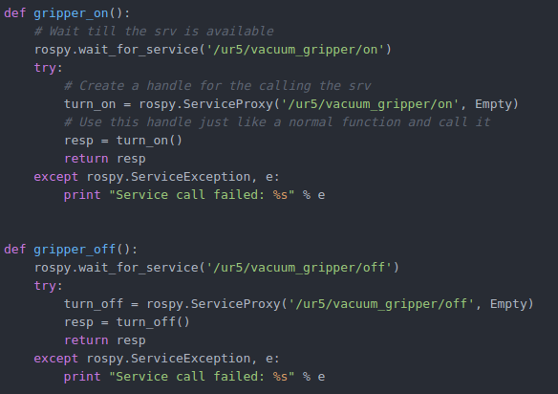
Vacuum gripper implementation

Slide 7
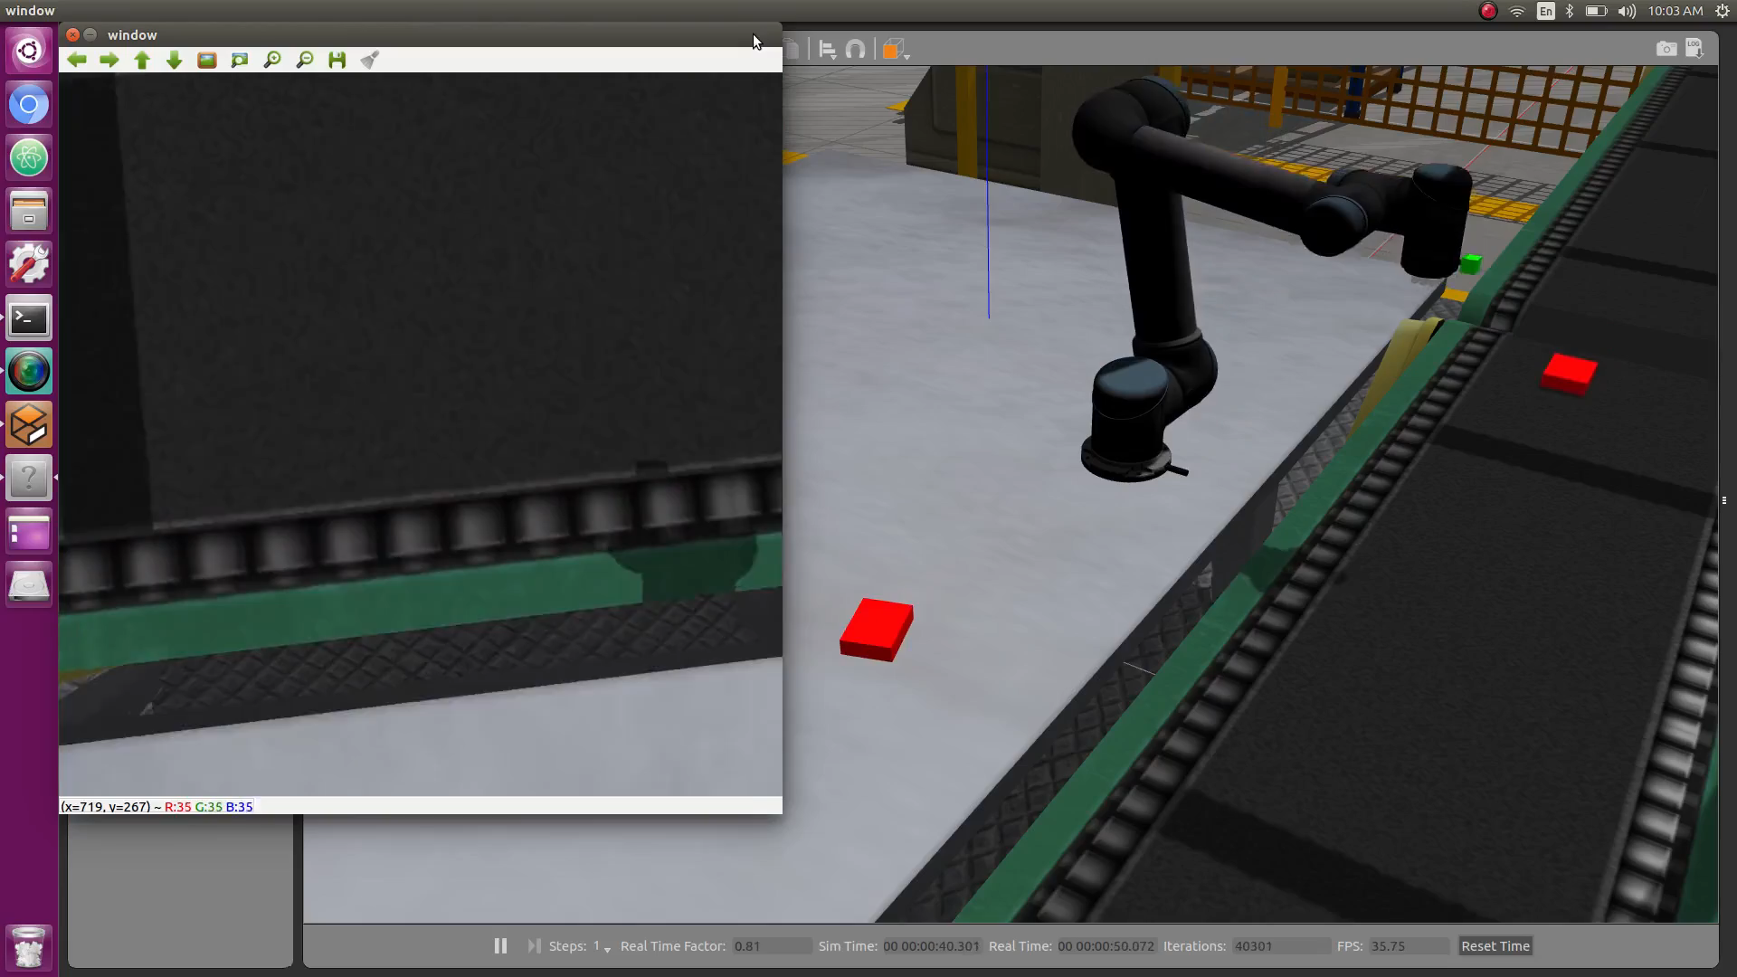
Images from the USB cam
Notes:
We combine UR5 vision and motion planning together to have this demo. An UR5 robot first tracks an object, after syncing up the speed with the object, the UR5 approaches the object and pick it up. Then UR5 follows predefined waypoints to deliver the object to the target area. UR5 goes back to the initial pose and tracks the next obejct

Slide 8
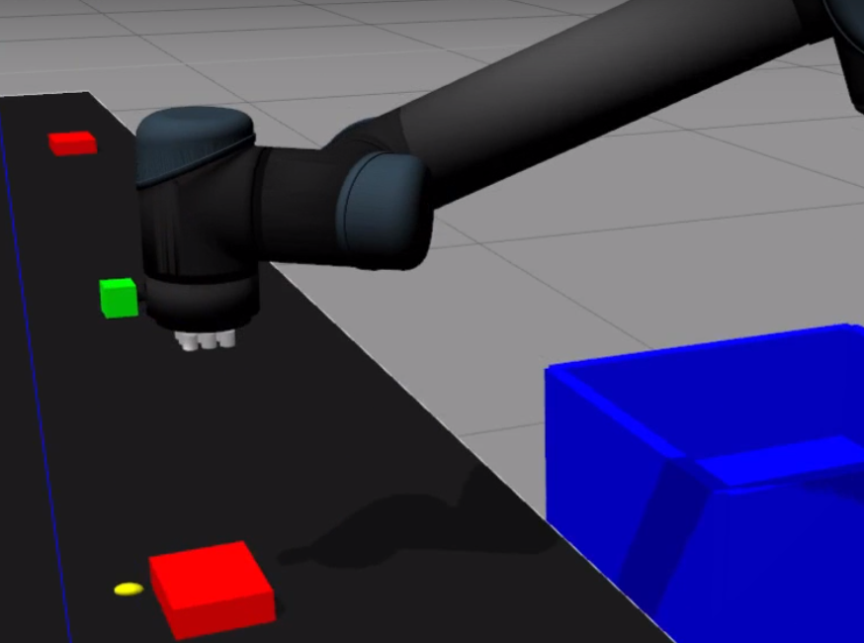
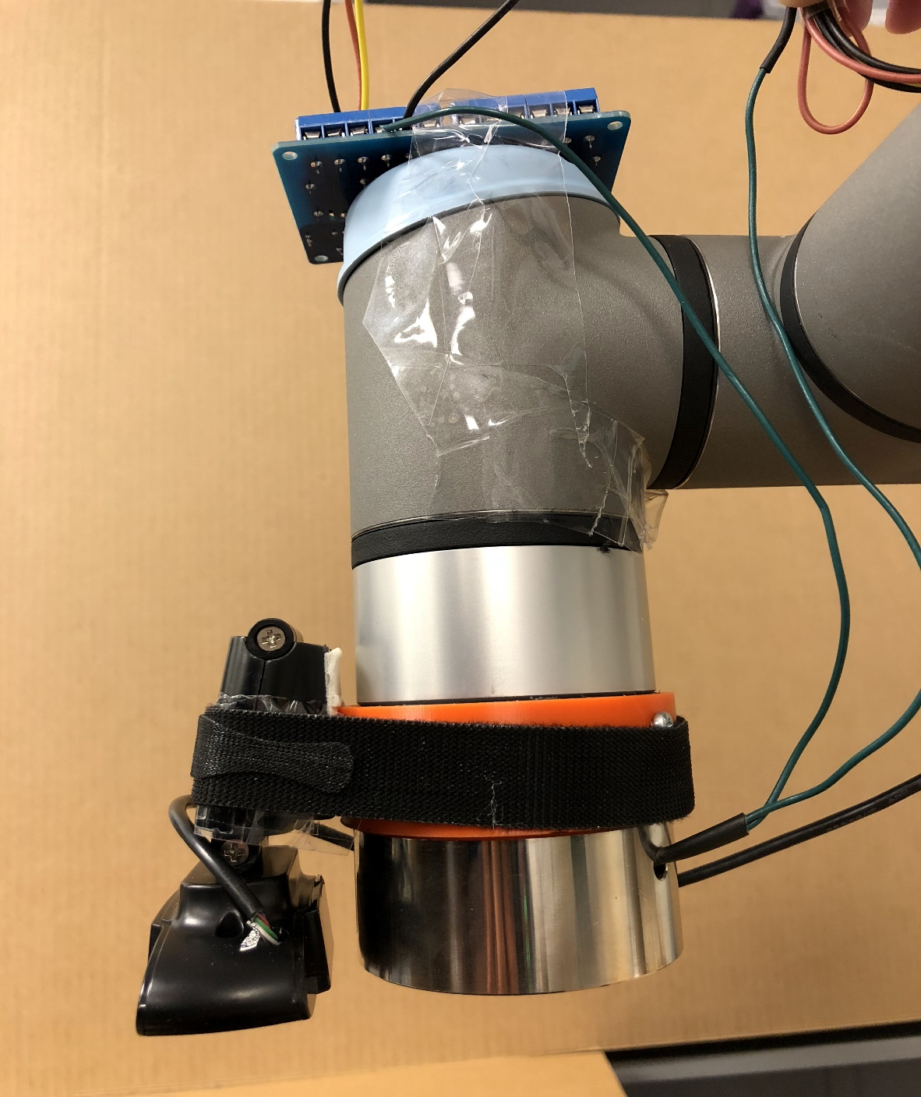
UR3 hardware implementation
Gripper
camera

Slide 9
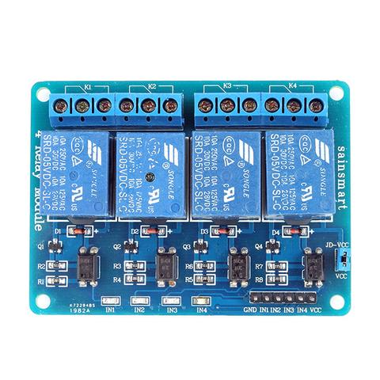
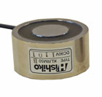
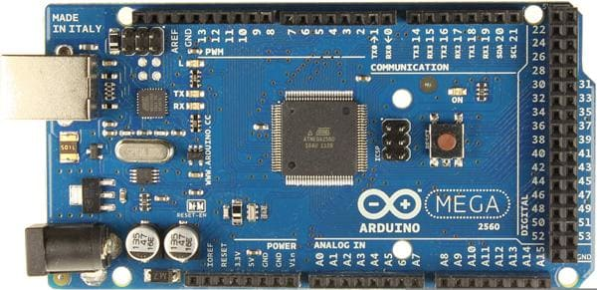
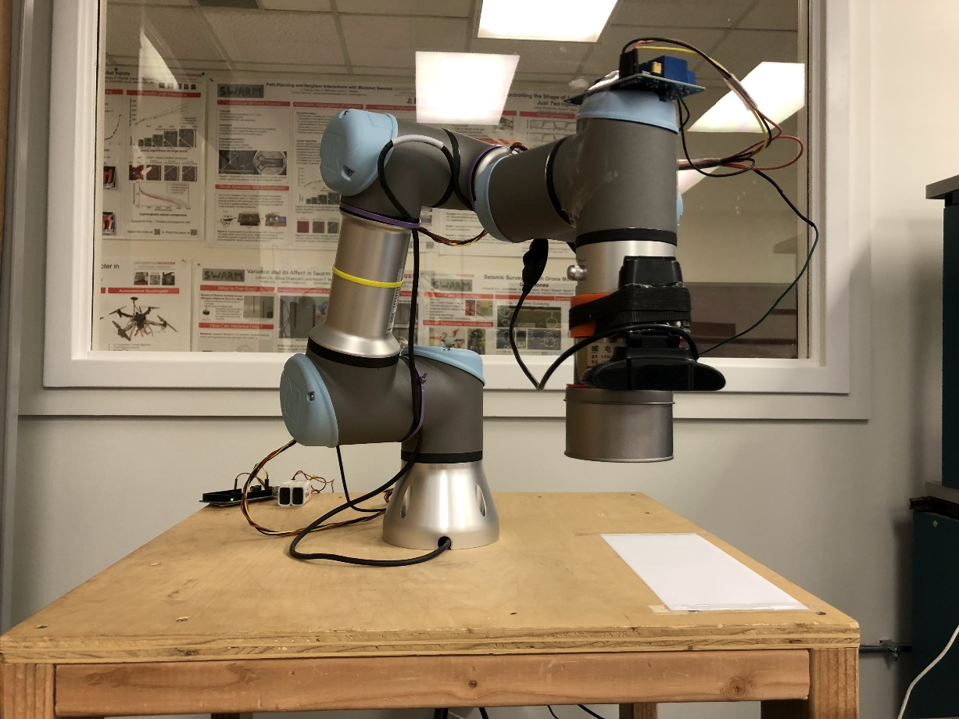
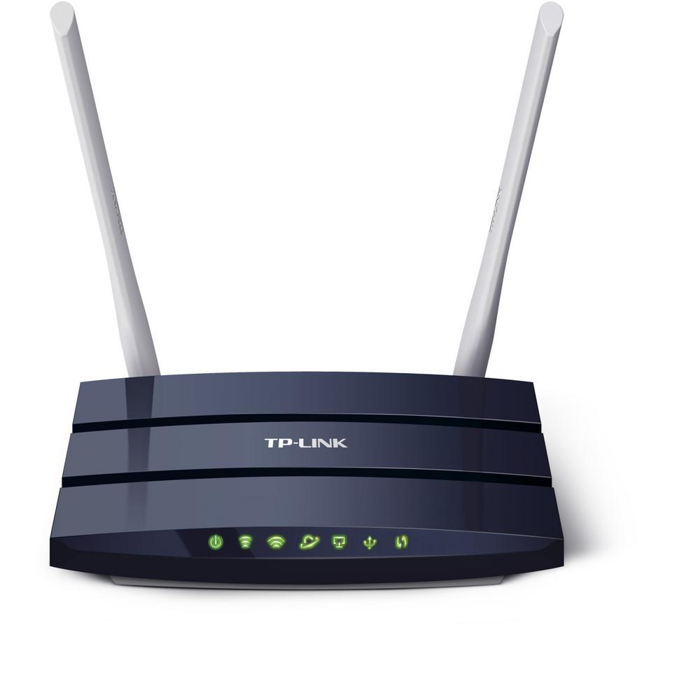
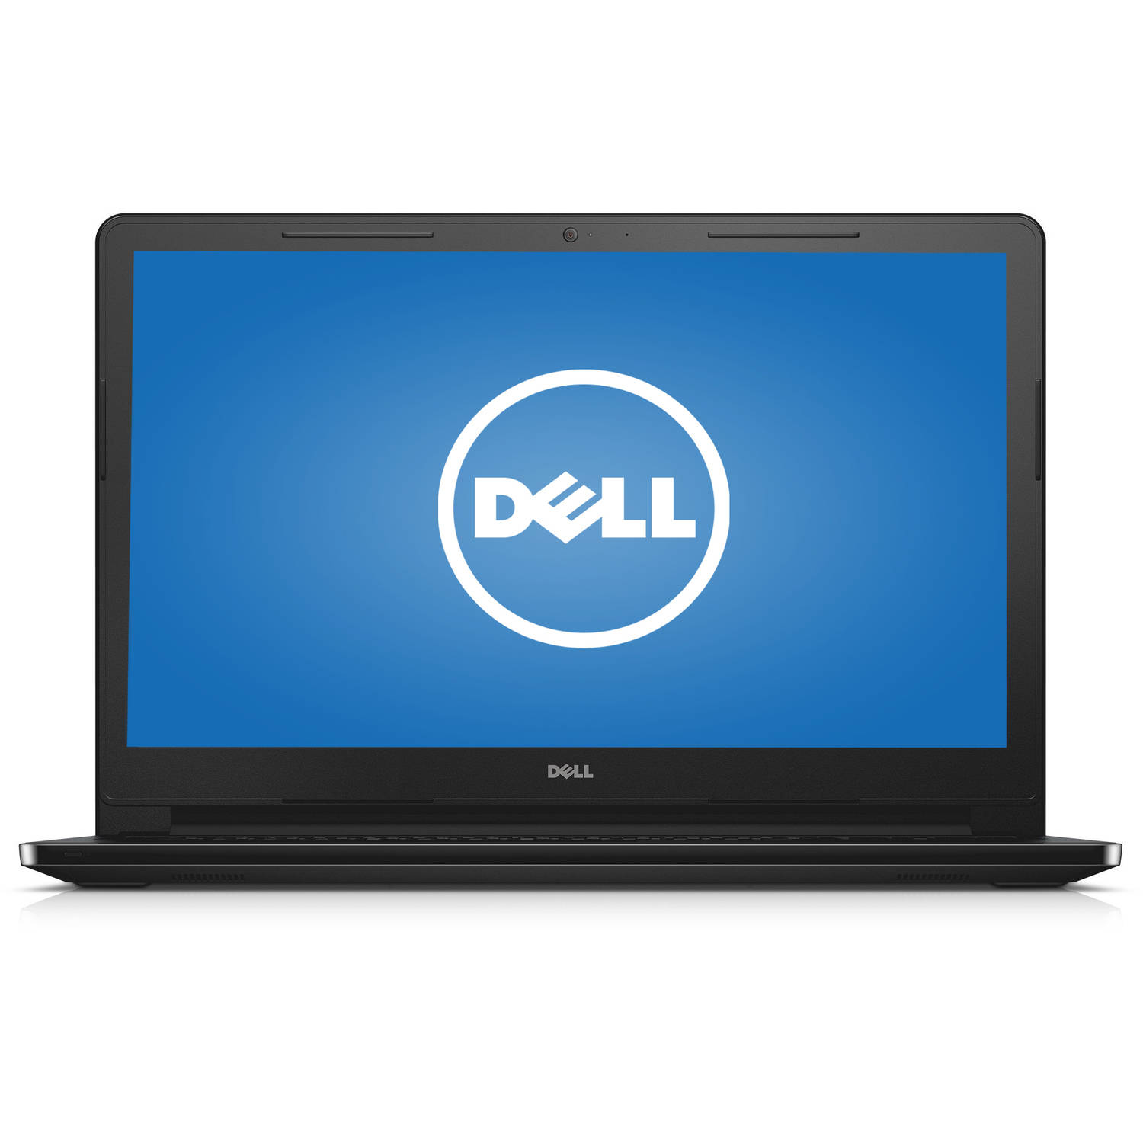
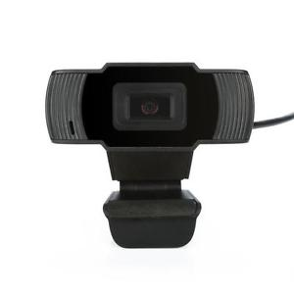
UR3 hardware implementation
Electromagnetic
Gripper
4-Channel SSR
Arduino Mega
Laptop
Wireless Router
UR3
USB Cam

Slide 10
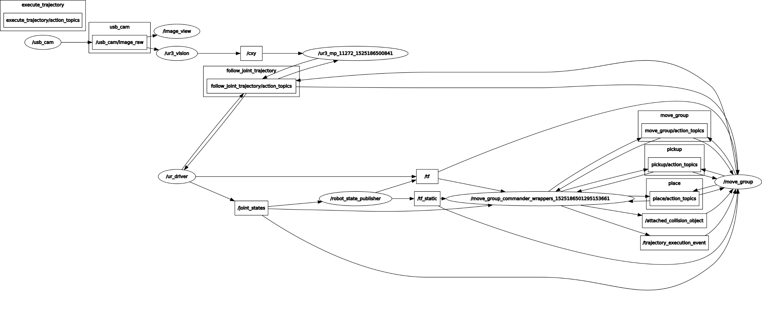
UR3 hardware implementation solution plan
Notes:
And this project also includes following scopes…

Slide 11
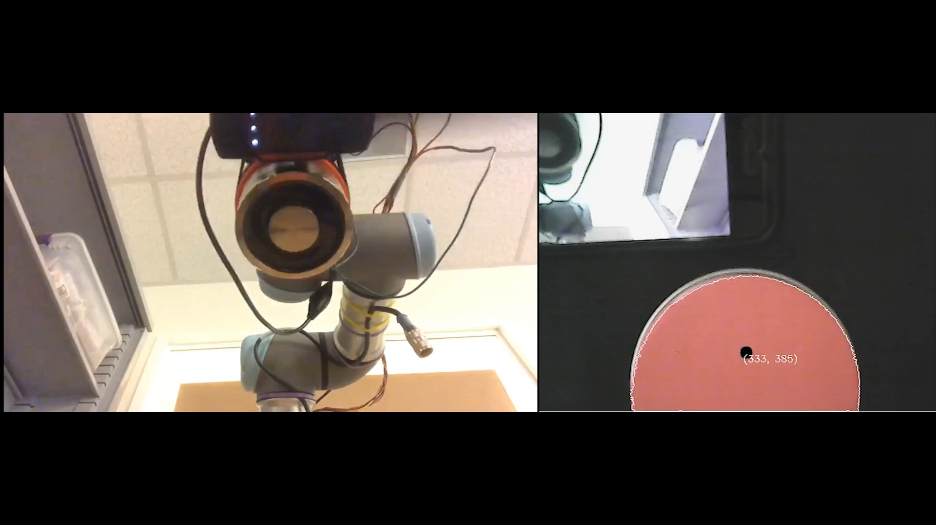
Object detection (OpenCV)
Bottom View
Camera Image
Notes:
An UR5 has 6 DOF, and it can be controlled either by specifying each joint angle, or by describing the pose of the end effector. On the left, with Rviz and MoveIt, we are able to drag the end effector around and change its orientation. An trajectory would be generated by MoveIt from the initial pose to the target pose given certain path planning algorithm. On the right is the Gazebo display.

Slide 12
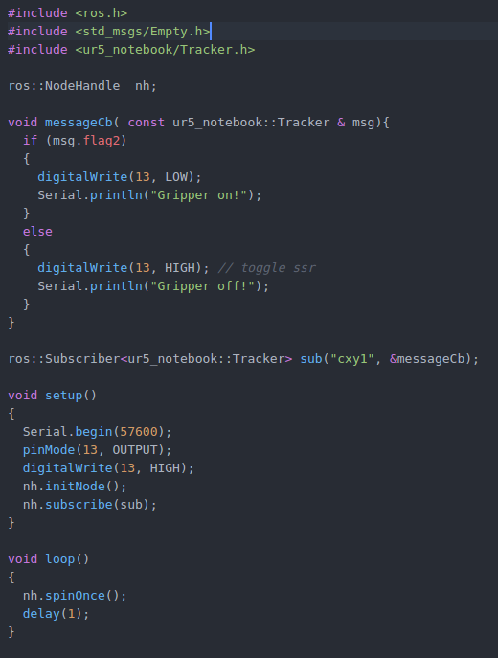
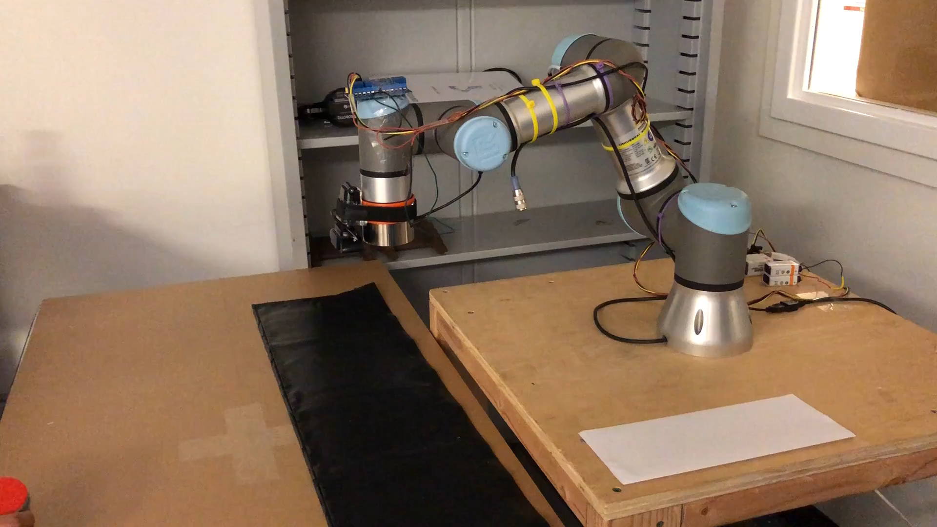
Electromagnetic gripper operation
Notes:
This the demo of motion planning using joints. As I mentioned we can use riviz to acuire initial position of end effector and joint status. In rviz we can drag the end effector to the desired position, and we can echo joint statues and control the ur5 position from command line.

Slide 13
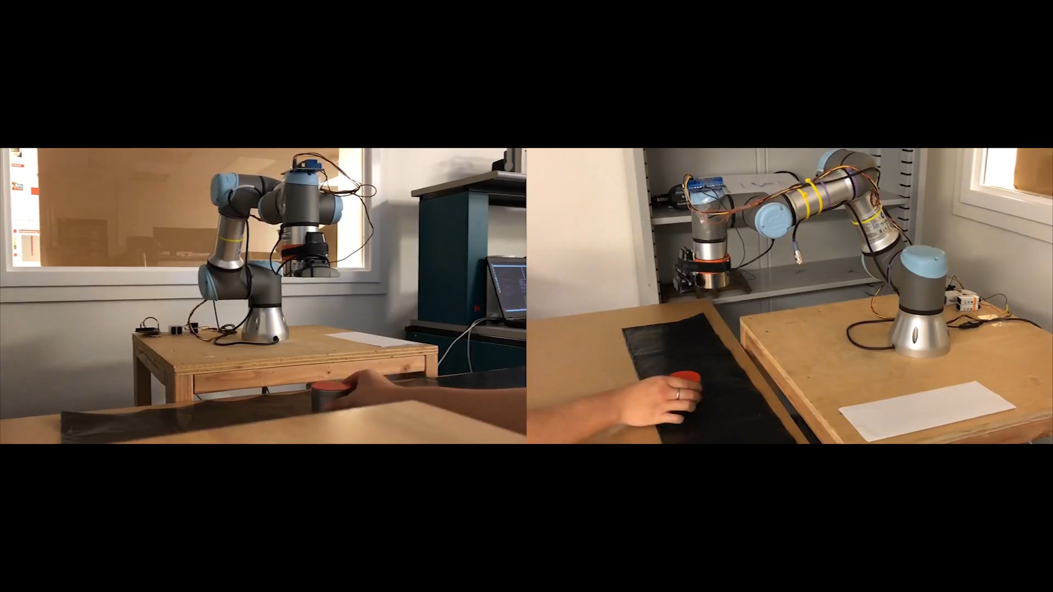
UR3 hardware implementation demo
Left View
Right View
Notes:
Performance description

Slide 14
Contribution
Online resources
Universal robot package
OpenCV library
Moveit package
Gazebo camera plugin
Gazebo vacuum gripper plugin
ROS-serial package (Arduino)
USB cam package
Team contribution
UR3 and UR5 motion planning
Color filter for object detection
PI controller for tracking
Customized ROS msg
Customized launch file
Gazebo URDF model
3D printed fixation for the gripper
Customized control circuits
USB cam and EM gripper installation

Slide 15
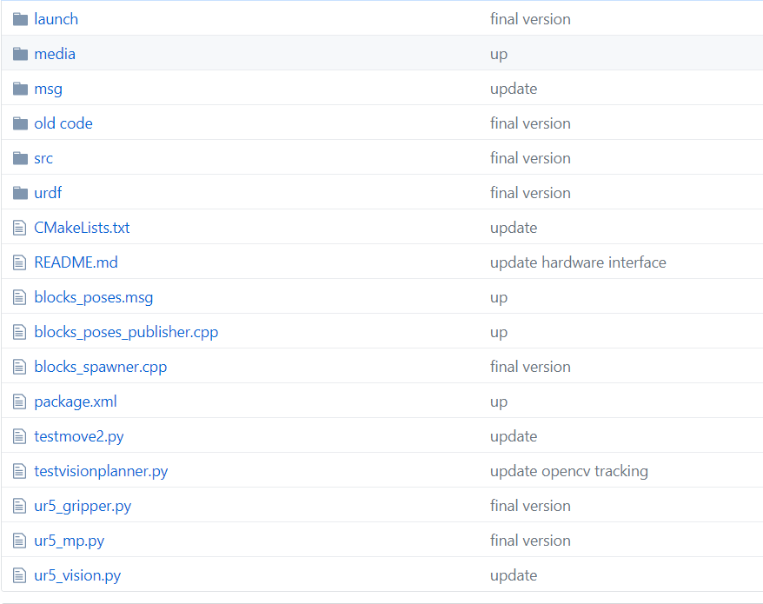
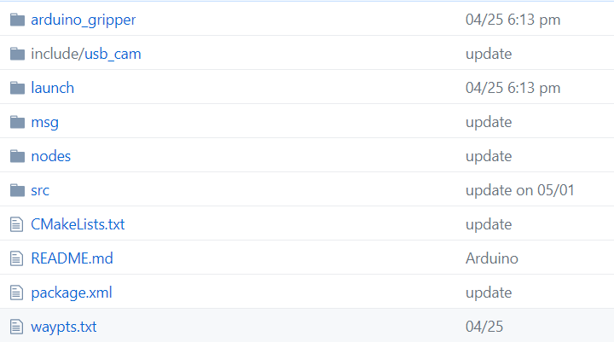
GitHub repository
UR5_notebook:
https://github.com/lihuang3/ur5_notebook
UR3_hardware:
https://github.com/lihuang3/ur3_hardware

Slide 16
Suggestions for future work
Object recognition instead of color filter.
Tf transformation provides better tracking performance and accuracy.
Moveit is used for motion planning, which is not in real time and thus there is motion delay during tracking.

